Slide 1
Access and Examine Landsat Land Cover (LC) Over the Sao Francisco Verdadeiro (SFV) Watershed
14 November, 2022
Notes:
National Aeronautics and Space Administration

Slide 2
Objectives
By the end of this exercise, you will be able to select, download, and analyze tree cover and bare ground data over the Sao Francisco Verdadeiro (SFV) watershed using the Landsat Land Cover (LC) portal and QGIS
Requirements
QGIS installed on your computer
https://arset.gsfc.nasa.gov/sites/default/files/water/drought/Introduction%20to%20QGIS.pdf
A shapefile for the Sao Francisco Verdadeiro watershed saved on your computer
http://arset.gsfc.nasa.gov/

Slide 3
Outline
Part 1: Select and Download Landsat Land Cover Data
Part 2: Examine Tree Cover and Bare Ground Extent Using QGIS

Slide 4
Note
Bare ground and tree cover data are in per pixel percent coverage based on 2000-2012 annual Land Cover
Bare soil cover is based on growing season coverage and represents minimum value
Tree cover is based on canopy cover within each pixel for trees 5 m or taller*
Water mask data is also available
Provides an overview of long-term mean water masks, areas dominated by tree cover, areas that may be bare ground, or other types of land cover over the SFV watershed
*Reference: Hansen, M. C., S. V. Stehman, P. Potapov, 2010: Quantification of global gross forest cover loss, PNAS, 107, 8650-8655, doi: 10.1073/pnas.0912668107

Slide 5
Part 1: Select and Download Landsat Land Cover Data

Slide 6
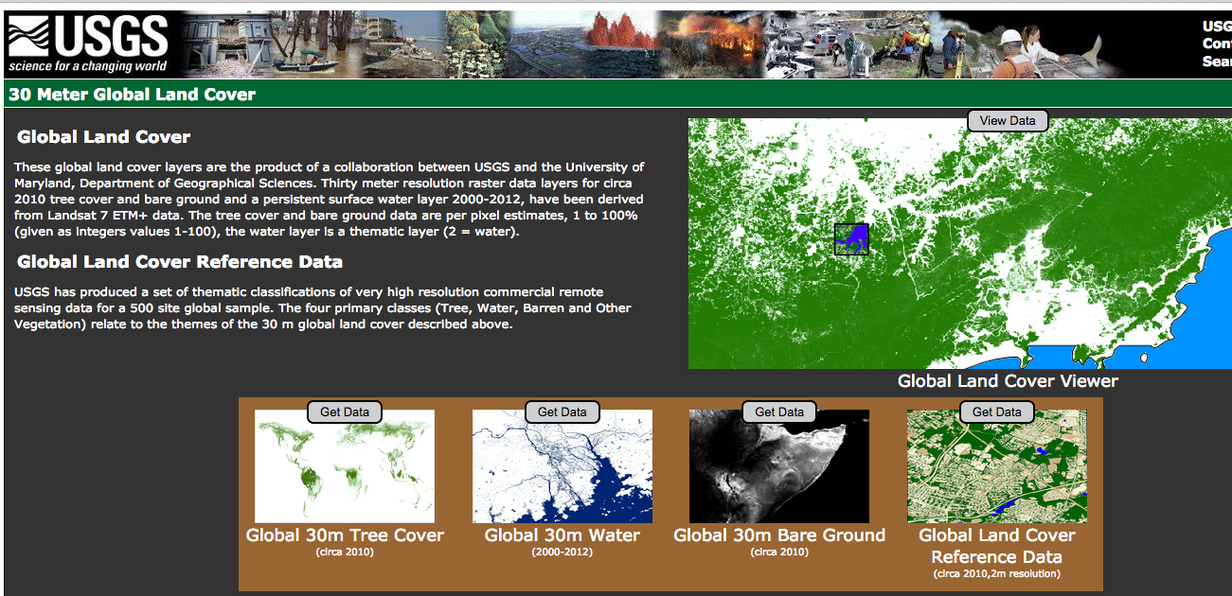
Select and Download Landsat Land Cover Data
On your computer make a folder named Land-Cover
Go to https://landcover.usgs.gov/glc/
You will see links to Global 30 m Tree Cover, Global 30 m Water, and Global 30 m Bare Ground data
Click on Get Data on top of the Global 30 m Tree Cover
Click on Individual Download
You will see a list of data files in 10° tiles covering the globe

Slide 7
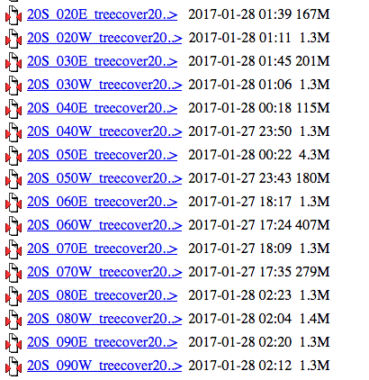
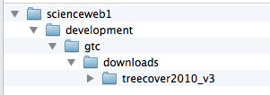
Select and Download Landsat Land Cover Data
Scroll down to the tile for 20°S and 60°W that contains the SFV watershed
Click on the link and save the file on your computer as zip archive (with .zip)
You will get a file named 20S_060W_treecover2010_v3.zip
Click on the file name to unzip the data and you will get a folder Stornext with the following sub-folders:

Slide 8
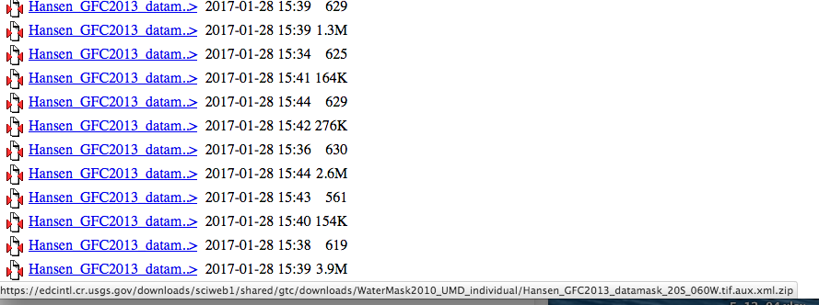
Select and Download Landsat Land Cover Data
In the treecover2010_v3 sub-folder you will have the tree cover data tile 20S_060W_treecover2010_v3.tif
Move the 20S_060W_treecover2010_v3.tif to the Land-Cover folder on your computer
Go back to https://landcover.usgs.gov/glc/ and click Get Data over Global 30 m Water
When you click on Individual Download you will see that the file names are different (Hansen_GFC2013—), but moving the curser on the file name will show the full name with latitude-longitude of the tile included in the file
Water Mask

Slide 9
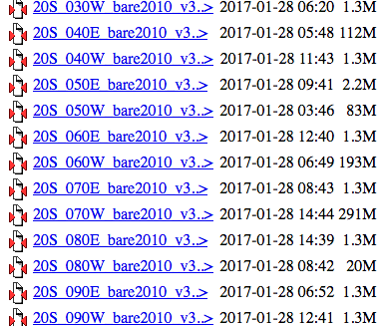
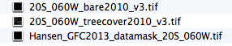
Select and Download Landsat Land Cover Data
Follow Steps 7-12 to save the file Hansen_GFC2013_datamask_20S_060W.tif containing water mask, in the Land-Cover folder on your computer
Note: be sure to download the file with the extension .tif.zip from the site
Repeat Steps 2-12 for the Global 30 m bare ground data
Save the file 20S_060W_bare2010_v3 in the Land-Cover folder
At the end of this part you will have the data files to the right in the Land-Cover Folder
Bare Ground

Slide 10
Part 2: Examine Tree Cover and Bare Ground Extent Using QGIS

Slide 11
Examine Tree Cover and Bare Ground Extent Using QGIS
Open QGIS and start a new project
From the top menu, click on Web, select Open Layer Plugin and select the background map OpenStreetMap
If you do not have the OpenLayers Plugin
Select Plugins from the top menu, and choose Manage and Install Plugins
You will get a window with options for Plugins
Enter OpenLayers in the search window
Clicking on the OpenLayers Plugin and press Install in the bottom right

Slide 12
Examine Tree Cover and Bare Ground Extent Using QGIS
Click on the menu on the left bar and click Add Vector to add the SFV shapefile: sfv_4326.shp
To make the shapefile transparent with only the border left, right click on the layer file and go to Properties > Style
Click on the down arrow in the Fill window and select Transparent fill

Slide 13
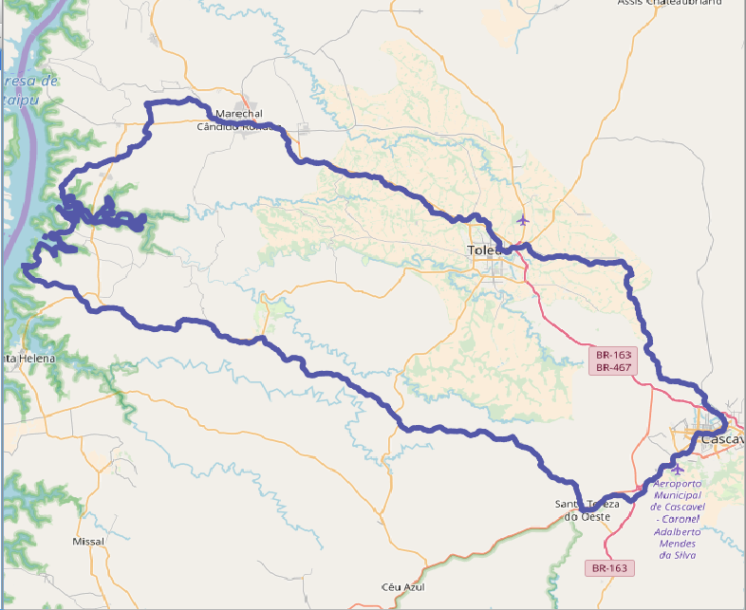
Examine Tree Cover and Bare Ground Extent Using QGIS
Click on the down arrow in the Outline window and choose a color of the shapefile boundary (This example uses purple)
Set the outline width to be 2.0
Click OK to get the following result in the QGIS window

Slide 14
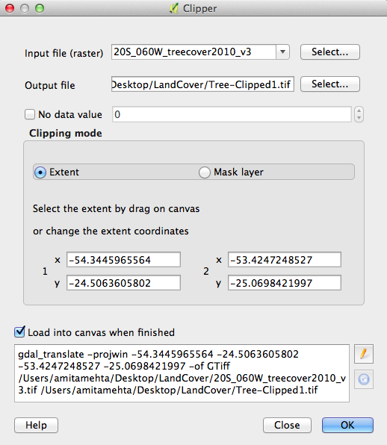
Examine Tree Cover and Bare Ground Extent Using QGIS
Next click on the Add Raster function on the left
Navigate to the Land-Cover folder and click to open 20S_060W_treecover2010_v3.tif data file
You will see the GeoTIFF images appear in grayscale
Now clip the tree cover raster layer to the SFV shapefile
This is a raster with large dimension, so we will clip this data in two steps

Slide 15
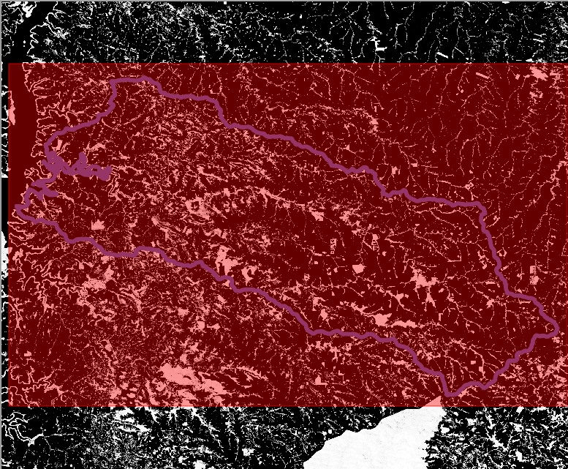
Examine Tree Cover and Bare Ground Extent Using QGIS
On the top bar go to Raster > Extraction > Clipper to open the Clipper options window
You will see Extent selected in the window
Enter Output file name by clicking on Select (Suggestion: tree-Clipped1.tif)
Drag the cursor across the map so that just the area around the shapefile is covered

Slide 16
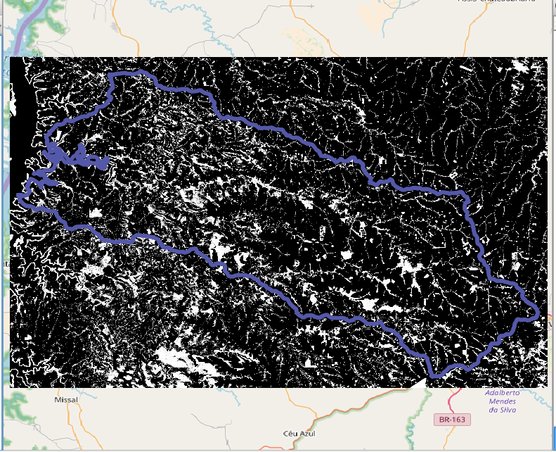
Examine Tree Cover and Bare Ground Extent Using QGIS
You will then see the rectangular clipped layer on the map
You can uncheck or remove the previous layer
Right click on the raster name in the Layer Panel > Remove
Now clip the pre-clipped layer to the SFV shapefile
On the top menu, go to Raster > Extraction > Clipper to open the Clipper options window

Slide 17
Examine Tree Cover and Bare Ground Extent Using QGIS
In the Input File (raster) window select the rectangular, clipped file: Tree-Clipped1
In the Output file window select output folder and enter file name (Suggestion: Tree-Clipped2)
Check the Mask Layer and in the Mask Layer window select the shapefile named sfv_4326
Click OK on at the bottom right.
You should see the data clipped by the shapefile boundary
To create a colored tree cover map, right click on the clipped raster layer
Go to Properties > Style

Slide 18
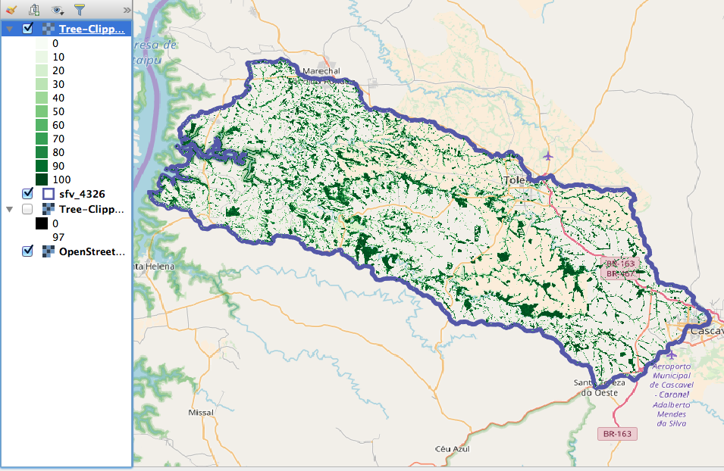
Examine Tree Cover and Bare Ground Extent Using QGIS
Select the Render Type as Singleband Pseudocolor
Next to Color, make sure the color palette is green by selecting (Greens)
Select Min value to 0 % and Max value to 100%
Below the color display, change the Mode to Equal Interval and Classes to 11. Click Classify, then click Apply.
Click OK to close the Change Color box

Slide 19
Examine Tree Cover and Bare Ground Extent Using QGIS
Make the clipped tree cover layers transparent to see the map underneath and to mask 0% values
Right click on the layer file and go to Properties > Transparency
Set the Transparency level to 50%
Under No data value enter 0 in Additional no data value
Click Apply and then OK

Slide 20
Examine Tree Cover and Bare Ground Extent Using QGIS
Repeat steps 9-11 but use the raster layer of bare ground cover from file Land-Cover/20S_060W_bare2010_v3.tif
Repeat Steps 12-25 with the two-step clipping of the raster layer, first with a rectangle and then using the SFV shapefile mask
Save the final, clipped file as Bare-Clipped2.tif
Repeat steps 26-32, but use yellow-orange-brown color (YlOrBr), min=0, max=9, with Mode set to Equal Interval and 10 Classes
Repeat steps 33-37 to make the layer 50% transparent and set No data value to 0 for Additional no data value

Slide 21
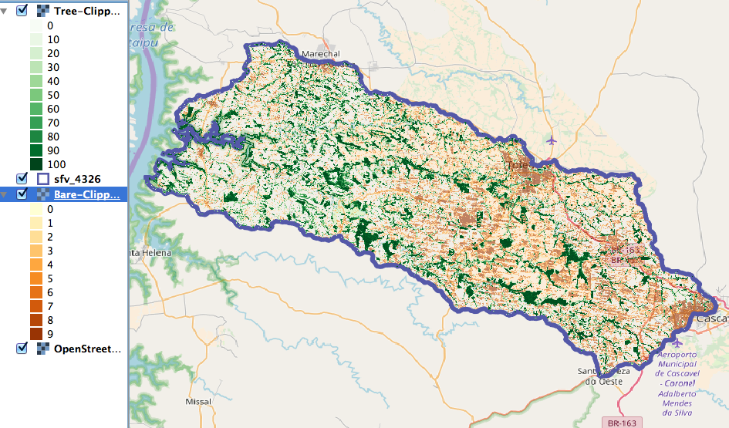
Examine Tree Cover and Bare Ground Extent Using QGIS
Display both Tree-Clipped2 and Bare-Clipped2 and examine the spatial land cover patterns
Add the water mask raster

Slide 22
Discussion Questions
Which part of the watershed has more wooded/forest areas in general?
What is the maximum per cent of bare ground cover noted on the watershed? Identify areas with large areas of bare ground.
Hint
Examine each layer individually and also note the geographic features in OpneStreetMap

